Slide 1
Lecture 7: Chemical Reactions and Aqueous Solutions
California State University, Fullerton
2023 Fall Semester – Chem 123

Slide 2

QUESTIONS, COMMENTS, AND CONCERNS?

Slide 3
Outline
Announcements
Ch. 4: Chemical reactions
Chemical equations – balancing the equation
Precipitation reactions – solubility rules
Ionic and net ionic equations
Acid-Base reactions
Oxidation States and Redox reactions

Slide 4
Announcements
All Grades are up to date; quick pep talk about homework extensions
How to Study: Practice! Practice! Practice!
Posted Study Guide
Problems throughout and at the end of the chapters
Flash cards
First exam week 5 on Weds, Sept 20th – covering Ch 1-4; 5-6 free response questions
Review Session after lecture ~6:00pm

Slide 5
Outline
Announcements
Ch. 4: Chemical reactions
Chemical equations – balancing the equation
Precipitation reactions – solubility rules
Ionic and net ionic equations
Acid-Base reactions
Oxidation States and Redox reactions

Slide 6
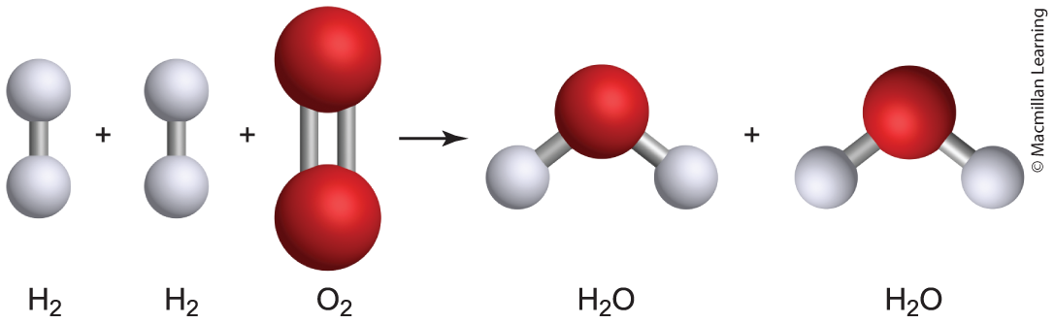
Chemical equation
aA + bB ---> cC + dD
General form of chemical equation is reactants (A, B) on the left and products (C, D) on the right
Coefficients a, b, c, and d in front of the chemical compound
Example: 2 H₂(g) + O₂(g) ---> 2 H₂O(g)

Slide 7
Chemical equation: Importance of coefficients
aA + bB ---> cC + dD
Balances the chemical equation due to the Law of Conservation of Mass
Number of atoms on the reactant side equals to number of atoms on the product side
Example: 2 H₂(g) + O₂(g) ---> 2 H₂O(g)

Slide 8
Chemical equation: Units of the coefficients
aA + bB ---> cC + dD
Mentioned in the previous side, the coefficient represents number molecules
Q: Coefficient represents something else. Hint: Recall Avogadro's number
Example: 2 H₂(g) + O₂(g) ---> 2 H₂O(g)

Slide 9
Chemical equation: Analogy to cookbook
Example: 2 H₂(g) + O₂(g) ---> 2 H₂O(g)
Every 2 moles H₂(g) and 1 mole O₂(g), there are 2 moles H₂O(g) produced

Slide 10
Chemical equations: physical states
Note: Phases must be written out for each compound
Gas – denoted as (g)
Liquid – denoted as (l)
Solid – denoted as (s)
Aqueous – denoted as (aq); compound dissolved in water

Slide 11
Outline
Announcements
Ch. 4: Chemical reactions
Chemical equations – balancing the equation
Precipitation reactions – solubility rules
Ionic and net ionic equations
Acid-Base reactions
Oxidation States and Redox reactions

Slide 12
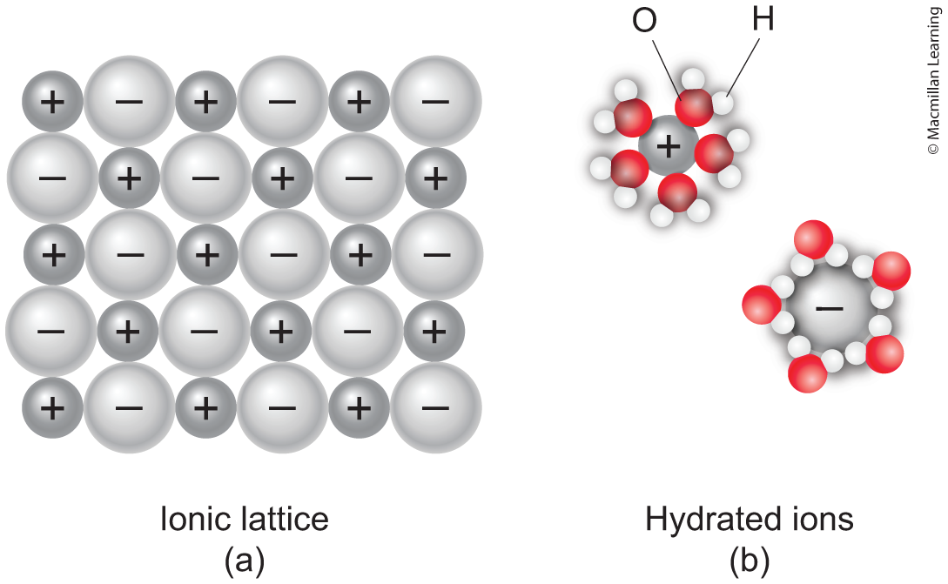
ionic compounds dissolved in water
Q: What does it mean when ionic compounds are dissolved in water?

Slide 13
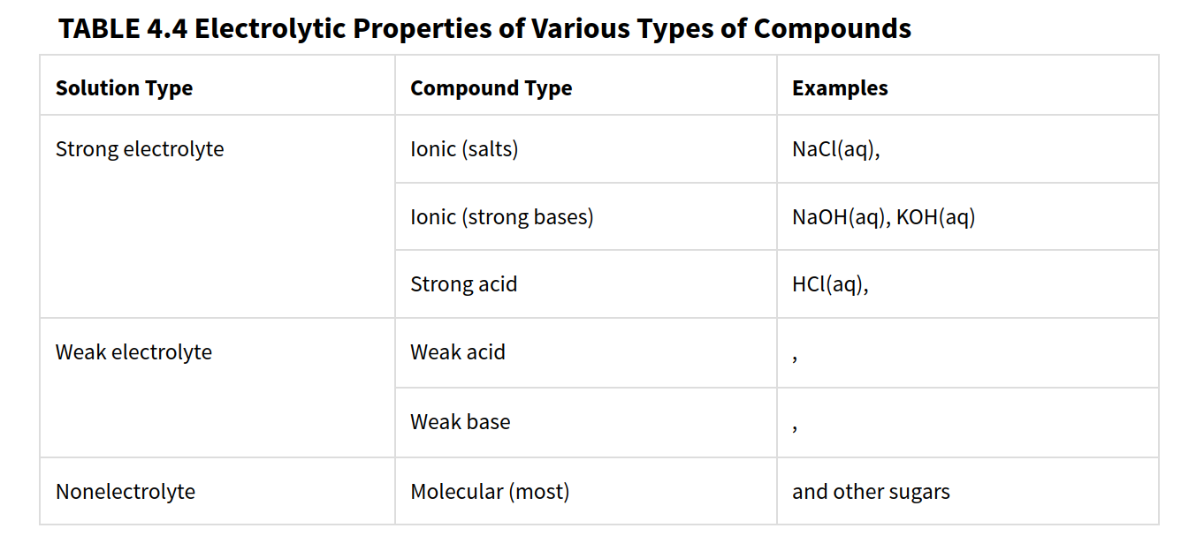
Strong, weak, and non-electrolytes

Slide 14
Precipitation reactions: solubility rules
Alkali earth metals and ammonium (NH₄⁺) are always soluble
Nitrates (NO₃⁻), chlorates (ClO₃⁻), perchlorates (ClO₄⁻), and acetates (C₂H₃O₂⁻) are always soluble
Chloride (Cl⁻), bromides (Br⁻), and iodides (I⁻) are soluble except with silver (Ag⁺), lead (Pb²⁺), and mercury (Hg²⁺)
Carbonates, sulfites, phosphates, and chromates are insoluble except with alkali earth metals and ammonium (NH₄⁺)
Hydroxides (OH⁻) and sulfides (S²⁻) are insoluble
Silver (Ag⁺), mercury (Hg₂⁺), and lead (Pb²⁺) salts are insoluble
Sulfates are soluble except with calcium (Ca²⁺), strontium (Sr²⁺), and barium (Ba²⁺)

Slide 15
Examples: Predict the solubility
AgNO₃
PbSO₄
KOH
BaCl₂
MgCO₃
PbCl₂
AgNO₃ Soluble
PbSO₄ Insoluble
KOH Soluble
BaCl₂ Soluble
MgCO₃ Insoluble
PbCl₂ Insoluble

Slide 16
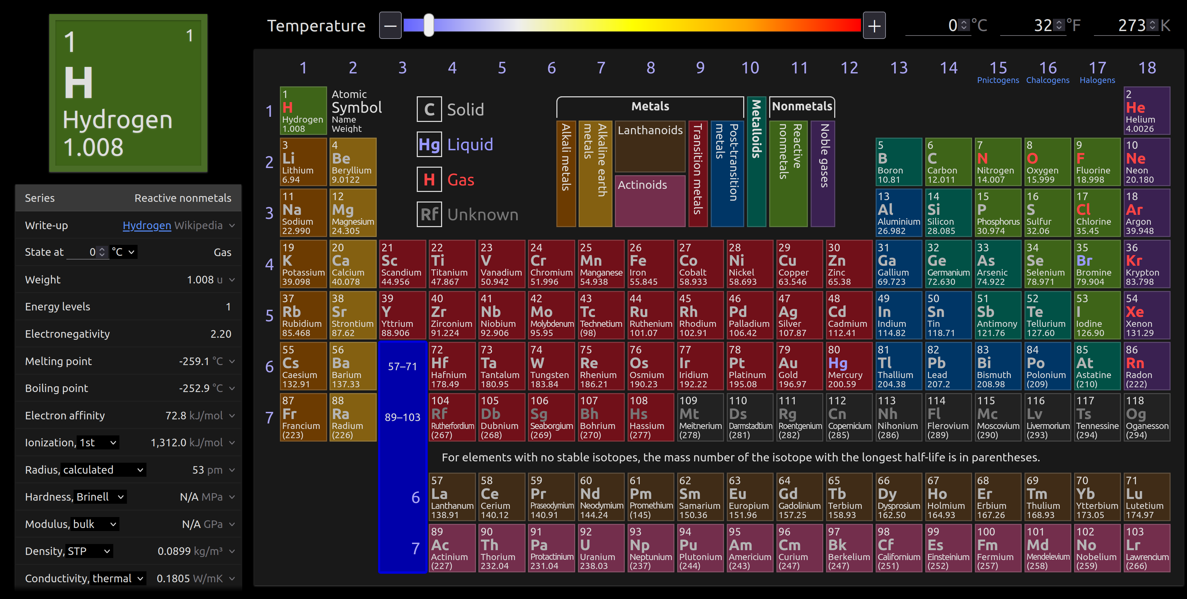
Know general trends - solubility

Slide 17
Outline
Announcements
Ch. 4: Chemical reactions
Chemical equations – balancing the equation
Precipitation reactions – solubility rules
Ionic and net ionic equations
Acid-Base reactions
Oxidation States and Redox reactions

Slide 18
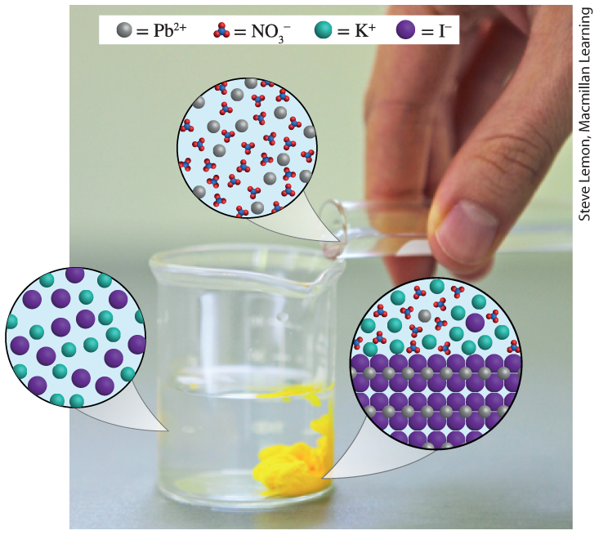
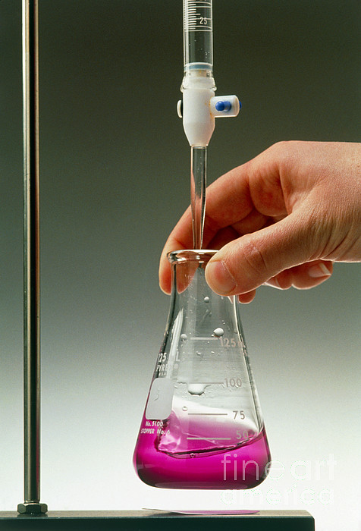
Double-replacement reactions (two types)
Two ionic compounds exchange ions to form new compounds
Examples: Precipitation (formation of solid) and Acid/Base

Slide 19
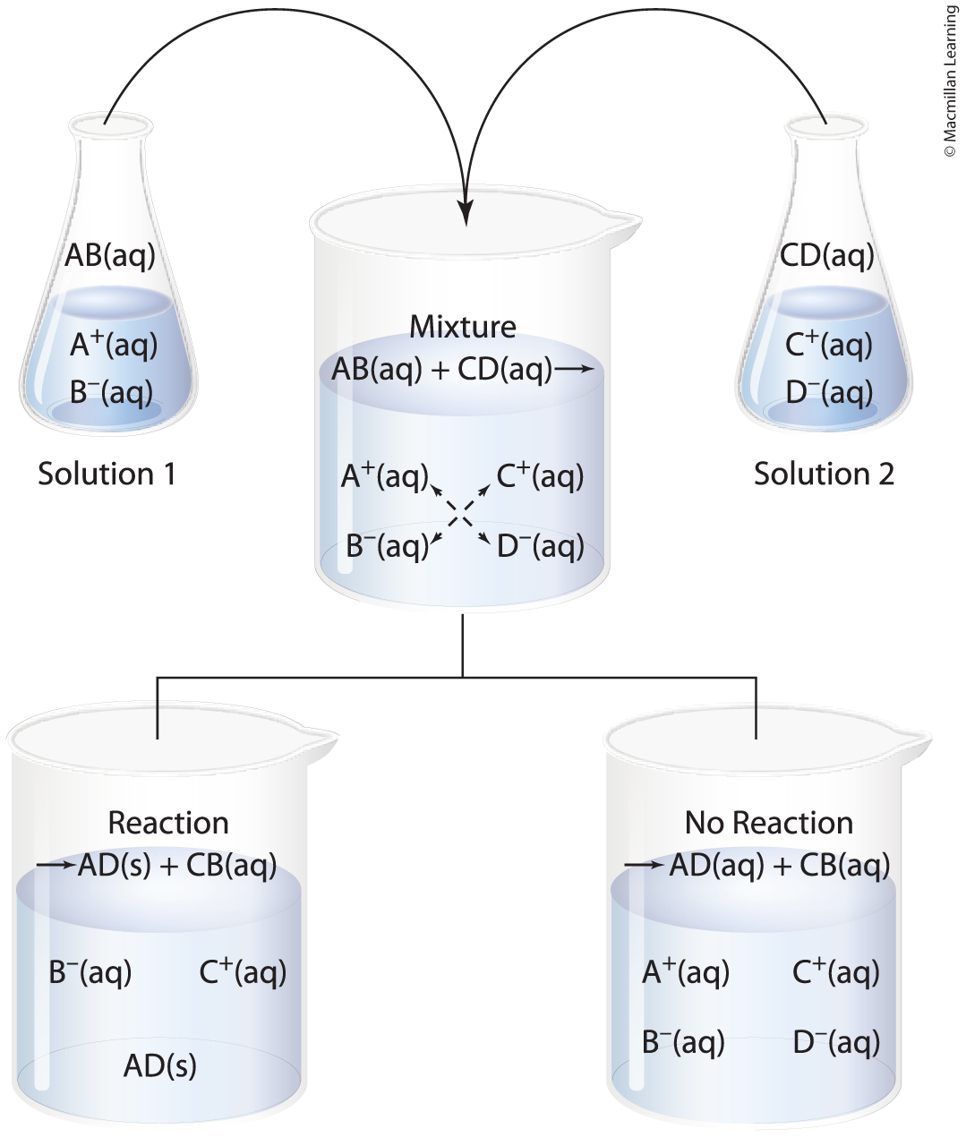
Approach for predicting precipitation reactions
Mixing two aqueous solutions, determine the ions and how many (balanced chemical equation)
Recombine the ions and determine the solubility
If soluble, then no reaction
If precipitate forms, then reaction happens

Slide 20
Example: determine the products formed
Na₃PO₄(aq) + CaCl₂(aq)
Determine all the ions formed and how much of each:
Na₃PO₄(aq) + CaCl₂(aq) ---> 3 Na⁺(aq) + PO₄³⁻(aq) + Ca²⁺(aq) + 2 Cl⁻(aq)
Recombine ions
3 Na⁺(aq) + PO₄³⁻(aq) + Ca²⁺(aq) + 2 Cl⁻(aq) ---> NaCl(--) + Ca₃(PO₄)₂(--)
Determine whether compounds are soluble or insoluble. Balance.
6 Na⁺(aq) + 2 PO₄³⁻(aq) + 3 Ca²⁺(aq) + 6 Cl⁻(aq) ---> 6 NaCl(aq) + Ca₃(PO₄)₂(s)

Slide 21
Example: determine the products formed
Na₃PO₄(aq) + CaCl₂(aq)
Compounds that are soluble – dissolves e.g. NaCl(aq)
6 Na⁺(aq) + 2 PO₄³⁻(aq) + 3 Ca²⁺(aq) + 6 Cl⁻(aq)
---> 6 Na⁺(aq) + 6 Cl⁻(aq) + Ca₃(PO₄)₂(s)
Known as the complete ionic equation
Na⁺(aq) and Cl⁻(aq) are spectator ions (do not participate in the reaction)

Slide 22
Example: determine the products formed
Na₃PO₄(aq) + CaCl₂(aq)
Remove spectator ions
2 PO₄³⁻(aq) + 3 Ca²⁺(aq) ---> Ca₃(PO₄)₂(s)
Known as the net ionic equation, only the ions participating in the reaction

Slide 23
Example: determine the products formed
Hg(NO₃)₂(aq) + KBr(aq)
Determine all the ions formed and how much of each:
Hg(NO₃)₂(aq) + KBr(aq) ---> Hg²⁺(aq) + 2 NO₃⁻(aq) + K⁺(aq) + Br⁻(aq)
Recombine ions
Hg²⁺(aq) + 2 NO₃⁻(aq) + K⁺(aq) + Br⁻(aq) ---> HgBr₂(--) + KNO₃(--)
Determine whether compounds are soluble or insoluble. Balance.
Hg²⁺(aq) + 2 NO₃⁻(aq) + 2 K⁺(aq) + 2 Br⁻(aq) ---> HgBr₂(s) + 2 KNO₃(aq)

Slide 24
Example: determine the products formed
Hg(NO₃)₂(aq) + KBr(aq)
Compounds that are soluble – dissolves e.g. KNO₃(aq)
Hg²⁺(aq) + 2 NO₃⁻(aq) + 2 K⁺(aq) + 2 Br⁻(aq)
---> HgBr₂(s) + 2 K⁺(aq) + 2 NO₃⁻(aq)
Known as the complete ionic equation
What are spectator ions (do not participate in the reaction)?

Slide 25
Example: determine the products formed
Hg(NO₃)₂(aq) + KBr(aq)
Remove spectator ions
Hg²⁺(aq) + 2 Br⁻(aq) ---> HgBr₂(s)
Known as the net ionic equation, only the ions participating in the reaction

Slide 26
Your turn: determine the products
K₂SO₄(aq) + BaCl₂(aq) --> ?
Write the complete ionic equation and net ionic equation. Determine the spectator ions.

Slide 27
Outline
Announcements
Ch. 4: Chemical reactions
Chemical equations – balancing the equation
Precipitation reactions – solubility rules
Ionic and net ionic equations
Acid-Base reactions
Oxidation States and Redox reactions

Slide 28
Acid-base reactions
Same approach – a variation of the double displacement reaction
Acid donates a proton (H⁺) and base accepts the proton (H⁺)
HCl(aq) + KOH(aq) --> H₂O(l) + KCl(aq)
Complete ionic equation
H⁺(aq) + Cl⁻(aq) + K⁺(aq) + OH⁻(aq) --> H₂O(l) + K⁺(aq) + Cl⁻(aq)
Q: What are the spectator ions?

Slide 29
Acid-base reactions
Same approach – a variation of the double displacement reaction
Acid donates a proton (H⁺) and base accepts the proton (H⁺)
HCl(aq) + KOH(aq) --> H₂O(l) + KCl(aq)
Net ionic equation
H⁺(aq) + OH⁻(aq) --> H₂O(l)

Slide 30
Outline
Announcements
Ch. 4: Chemical reactions
Chemical equations – balancing the equation
Precipitation reactions – solubility rules
Ionic and net ionic equations
Acid-Base reactions
Oxidation States and Redox reactions

Slide 31
rules for oxidation states
Neutral element that is not part of a compound has an oxidation state of 0 e.g. Na, Al, N₂, O₂, Br₂
Monoatomic ions have oxidation states equal to their ionic charges e.g. Mg²⁺, O²⁻
Sum of the oxidation states in any chemical formula is equal to the overall charge on that formula e.g. NO₃⁻, SO₄²⁻, NH₄⁺
Oxygen tends to have an oxidation state of –2 in compounds
Hydrogen tends to have an oxidation state of +1 in compounds
Nonmetal elements in halogens are –1 charge in compounds
Alkali metals and alkaline earth metals are +1 and +2, respectively

Slide 32
Examples: determine the oxidation states
S₂O₃²⁻
Oxygen is –2 charge. Therefore, sulfur is +2.
SO₃²⁻
Oxygen is –2 charge. Therefore, sulfur is +4.
H₂
Hydrogen is 0 charge.

Slide 33
identifying redox reactions
Definition: transfer of electron from one substance to another
Example:
2 Al(s) + 3 Cl₂(g) --> 2 AlCl₃(s)
Al(s) and Cl₂(g) have 0 zero charge
Within AlCl₃(s), Al has +3 charge and Cl has –1 charge.
Q: Where is the electron being transfer from and to which elements?

Slide 34
Redox reaction
Example:
2 Al(s) + 3 Cl₂(g) --> 2 AlCl₃(s)
Oxidized – losing electrons; Al(s) is oxidized (losing 3 electrons)
Reduced – gaining electrons; Cl₂(g) is reduced (gaining 3 electrons)
OILRIG – Oxidized is losing. Reduced is gaining.

Slide 35
Redox reaction
Example:
2 Al(s) + 3 Cl₂(g) --> 2 AlCl₃(s)
Oxidizing agent – substance that causes the other to lose electrons; Cl₂(g) is oxidizing agent
Reducing agent – substance that causes the other to gain electrons; Al(s) is reducing agent

Slide 36
Redox reaction: Single displacement reaction
Your turn:
Zn(s) + 2 HCl(aq) --> ZnCl₂(s) + H₂(g)
Determine which reactant is oxidized, reduced, oxidizing agent, and reducing agent.
OILRIG – Oxidized is losing. Reduced is gaining.

Slide 37
Where to find extra practice?
End of chapter problems!
Posted Ionic and REDOX worksheet

